Slide 1

2026 PHCC Membership Renewal – Kick Off Webinar
September 10 | 2:00pm EST

Slide 2

Welcome & Purpose
• Today’s Objectives:
  Discuss overall member renewal behaviors and PHCC renewal data
  Review dues renewal process, deadlines, tools, and resources
  Roundtable Q&A

Slide 3
Insights & Benchmarks for Associations
Overall Renewal Rates
Median renewal rate: 85%
New member renewal: 75%
Trade associations: 90%
PHCC Renewal Rate Avg: 85%
Number of Reminder Touchpoints
Typical: 4 renewal emails per cycle
Small association: 2-3 notices
Best outcomes: 7-15 contact (email, mail, phone)
PHCC Touchpoints: 4-6 emails
Renewals by Membership Year
First-year: 65-75%
After first renewal: Likelihood jumps from 50 – 80%
PHCC First Year renewals: 73%
Timing is Key
Renewal outreach begins 3 months prior to expiration
Continues 2-3 months post expiration (grace period)
Exact 'per email' stats are rare because most associations track aggregate success not individual touchpoints.
Pattern: First email = most renewals, middle = steady gains, final = small but important
72% of PHCC members renewed between Oct-Jan for 2025 renewal cycle

Slide 4
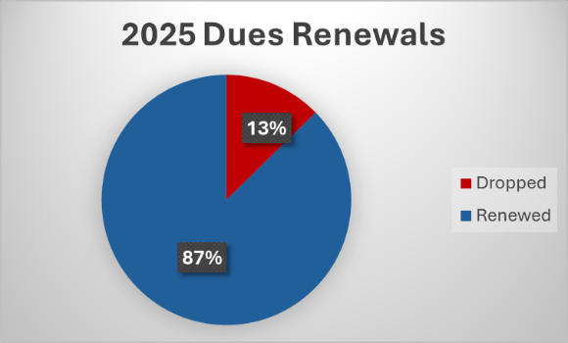
Member Renewal Data and 2026 Goals
2026 Goals:
Recruit more new members in 2026
Increase 2026 retention to 90%
Year | Total | New | Dropped | Retention
2023 | 3,119 | 350 | 380 | 87%
2024 | 3,023 | 320 | 428 | 85%
2025 | 2,735 (Apr 15) | 171 (Aug 31) | 302 (Apr 15) | 87%

Slide 5
2026 Billing Schedule - Major Makers/Deadlines
September 30
  Dues Billing Request Forms due
  Roster edits due to National Office
October 15
  Invoices available in NetFORUM for members (At-Large & PHCC managed billing)
  Invoices available in Versapay for chapters that do their own billing
  First email to PHCC At-Large members and chapters that PHCC manages billing
December 31 – Member early bird deadline to receive 5% discount
January 31 – Early bird deadline for Chapters that manage their own billing to receive 5% discount
April 15 – All member drop date

Slide 6
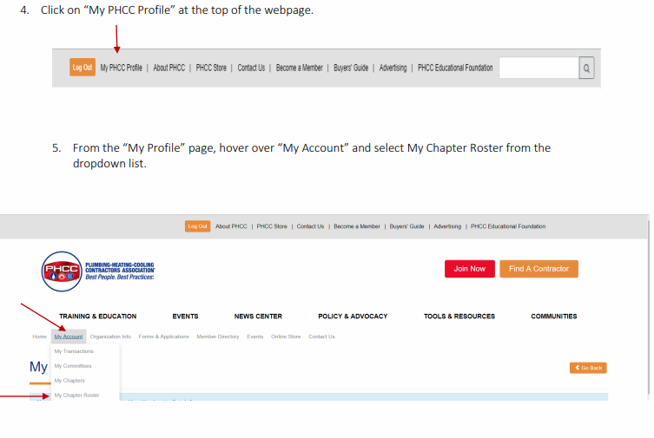
Chapter Rosters
• Deadline for edits/additions: September 30
• Ensure rosters are up-to-date → affects invoices & member records
  How to pull your roster from your Chapter Profile (Chapter Resource Center)
• Helps eliminate billing errors later
Bottom line: when we work in partnership with you --- we can guarantee accurate, efficient, reliable member records.
A smooth and timely renewal cycle = members that renew. It’s like muscle memory.

Slide 7
Versapay Overview
• Invoices uploaded by October 15
• Calendar invite for refresher training → late September
• Benefits: streamlined, transparent, easier payments

Slide 8
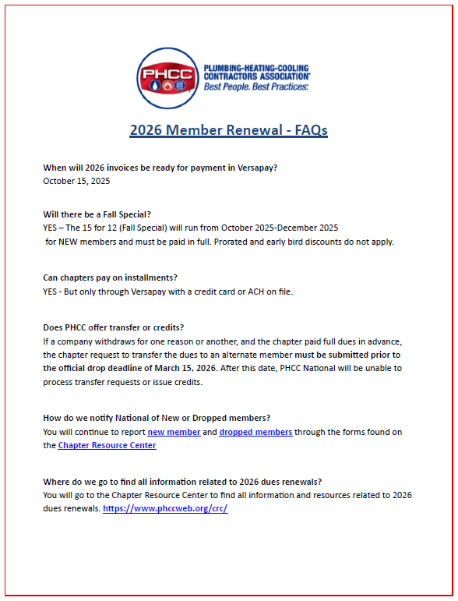
FAQs
• Common questions covered in FAQ document
• Examples: credits, transfers, deadlines
• Always reach out with additional questions

Slide 9
At-Large Renewal Campaign
• At-Large: 2026 At-Large campaign
  Themes
    Now more than ever
    Reminder of value and community
    Leveraging Leaders – Personal Impact
    Tap on the shoulder
    Urgent
  Timing/Approach
    4-6 emails from Oct – Apr
    Segment audiences
    Phone calls
What works best for your Chapter?

Slide 10
Key Deadlines Recap
Sept 30 → Roster edits due
Late Sept → Versapay and roster pull refresher session
Oct 15 → Invoices live in Versapay
Oct – Jan → Renewal outreach
Feb-Apr → Grace period
Apr 15 → Drop date

Slide 11
Support & Next Steps
PHCC National
State Chapter
Local Chapter
PHCC Leaders
PHCC Member
WE ARE PHCC

