Slide 1

CONNECT 2025
What to Expect and How to Help
Wednesday, August 27 – 2-3pm ET

Slide 2

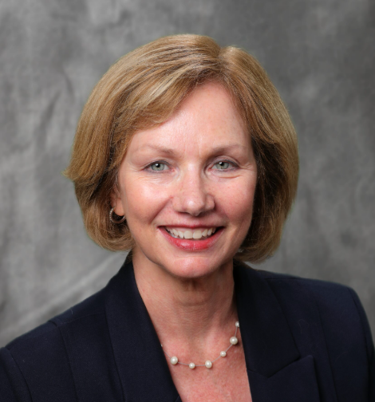
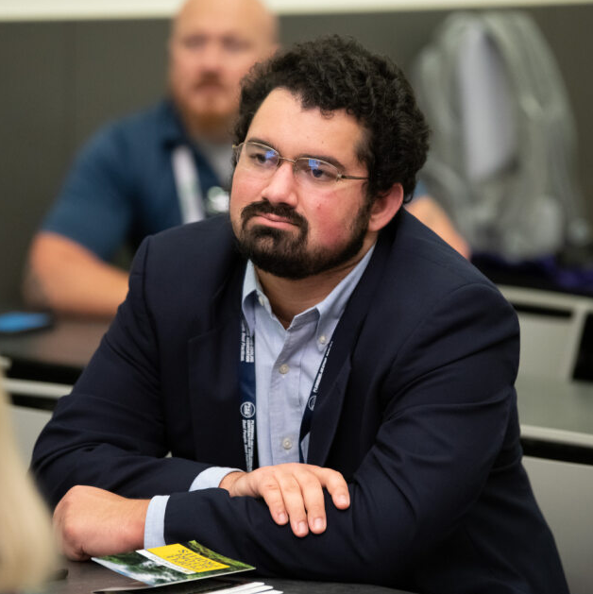

CONNECT Marketing: Available Tools
Charlotte Perham Neil Leisenring
VP, Communications Marketing Manager
PHCC—National Association PHCC—National Association

Slide 3




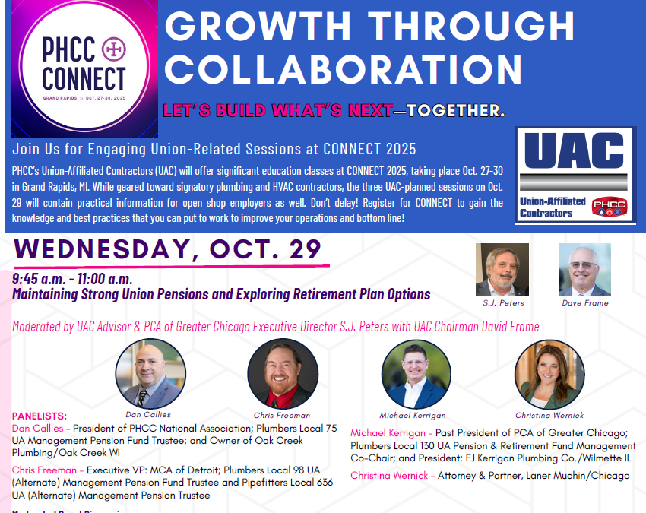
CONNECT 2025 Marketing Tools
Print ads
Flyers
Web banners
Digital ads
Chapter
Resource Content
Social Media Kit

Slide 4
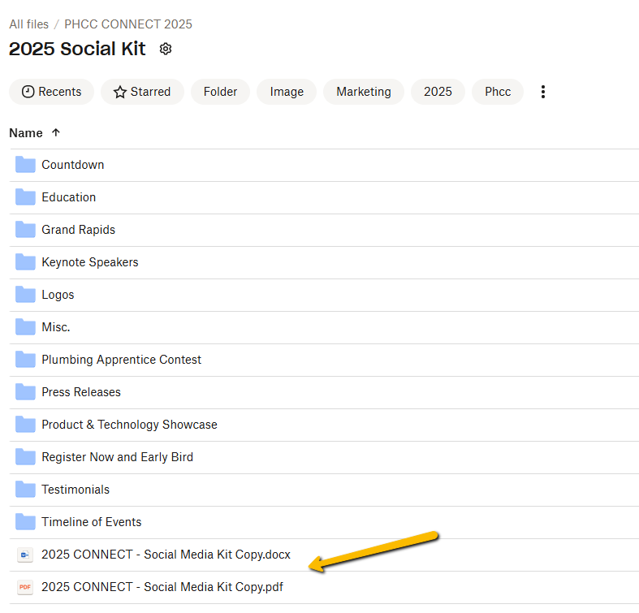
CONNECT 2025 Social Media Kit
Find in Chapter Resource Center
“2025 CONNECT-Social Media Kit Copy” Document
Images in folders align with social media copy options
Thank you for engaging with us!

Slide 5
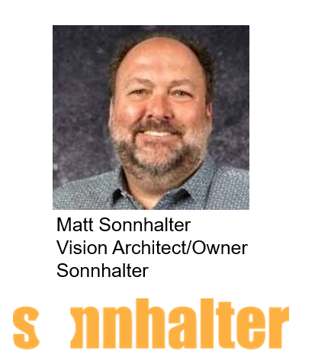
Sonnhalter CONNECT 2025 Update
Comprehensive Marketing Plan
Priorities for 2025

Slide 6
5 Industry Event Marketing Trends
Gathered from conversations with industry media, manufacturers and PHCC chapter executives, as well as ASAE reports.
Folks are registering later for events
Early bird discounts are not as much of a draw
One-on-one informal emails (contractor-to-contractor) can help convince someone to attend
Print marketing continues to decline
Social media is a key resource for contractors leading up to, during and after the event

Slide 7
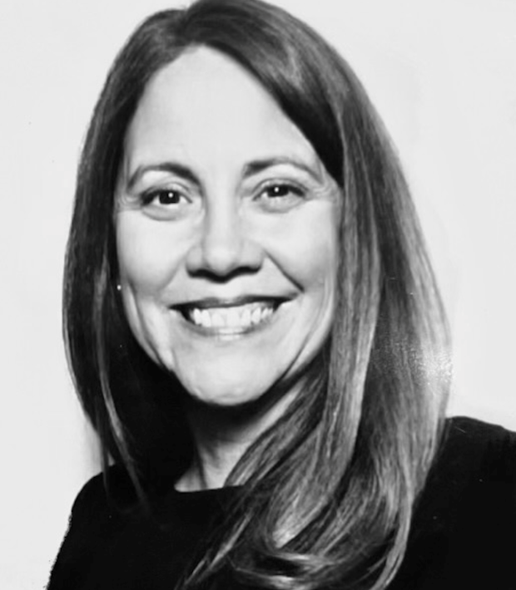
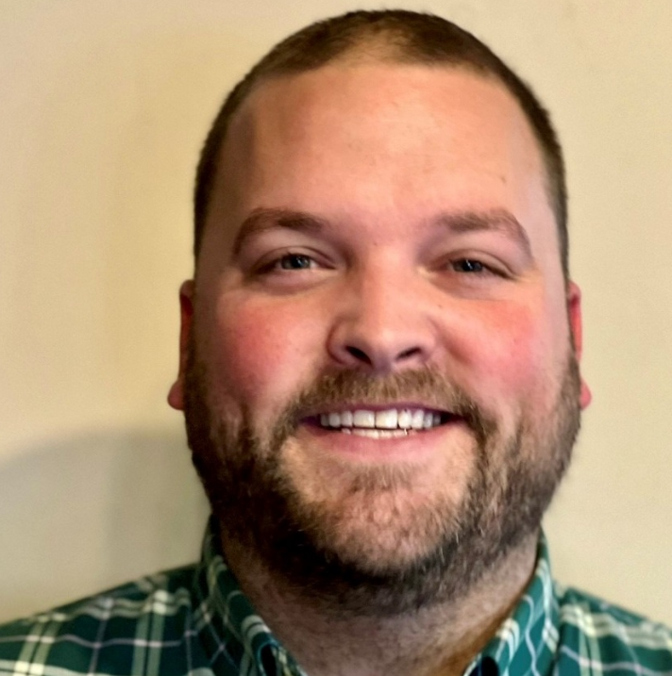
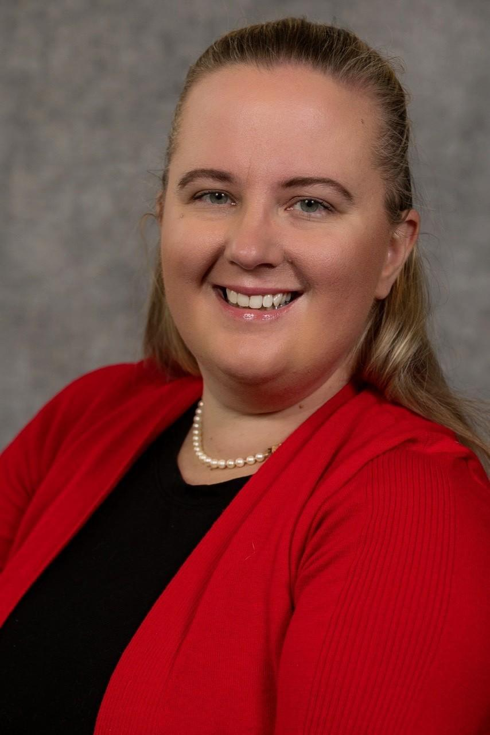

CONNECT: Onsite Experience
Tanya Coogan Jordan Fleger
Sr. Director, Membership Manager, Membership
PHCC—National Association PHCC—National Association
Elizabeth Davis
Managing Director
CM Event Solutions

Slide 8
Chapter Executive Experience
Overview of the venue (map)
Space available at the conference center – send requests to Jordan ASAP (fleger@naphcc.org )
Walkable restaurants for board/members for dinner
Chapter President and Executive Director Leadership Lunch – Wednesday, October 29 – 12:45 – 2pm

Slide 9
Member Experience – We Are PHCC
Member Experience Area (Booth)
        Interactive
  Member Since____Buttons – Member Record Audit
  New Giveaways
  Chapter Execs welcome to spend time in booth
  Places to sit and reconnect with colleagues or have 1:1/small group meetings
  Charging stations

Slide 10

Questions?

Slide 11
Important Reminders | Save the Date
September 10, 2pm ET – 2026 Membership Renewal Kick Off
September 17, 2pm ET – Leadership Lab | Membership Profile Survey Results
October 1, 2pm ET – Annual Business Meeting
October 27-30 – CONNECT 2025
October 19-22, 2026 – CONNECT 2026 (Milwaukee, Wisconsin!)

Slide 12

Thank You to Our Sponsor

Slide 13

We'll See You There!

