Slide 1

Chapter Resource Center
Member Renewal Status
Renewal – Best Practices & Share Outs
Wednesday, March 12 – 2-3pm ET

Slide 2
PHCC Chapter Resource Center - Your One-Stop Hub for Chapter Success
The PHCC Chapter Resource Center is designed to equip our chapter executives with the essential tools, forms, and resources needed to effectively manage and grow their chapters. This centralized online hub provides:
✅ Key Administrative Forms & Templates – membership, governance and operational documents
✅ Marketing & Membership Tools – communications content and recruitment materials
✅ Important Dates & Reports – zone meetings/reports , upcoming CLASS sessions
✅ Governance Materials – bylaws and policies
Easily accessible and continuously updated, the Chapter Resource Center ensures our chapters have everything they need at their fingertips to thrive and succeed.

Slide 3
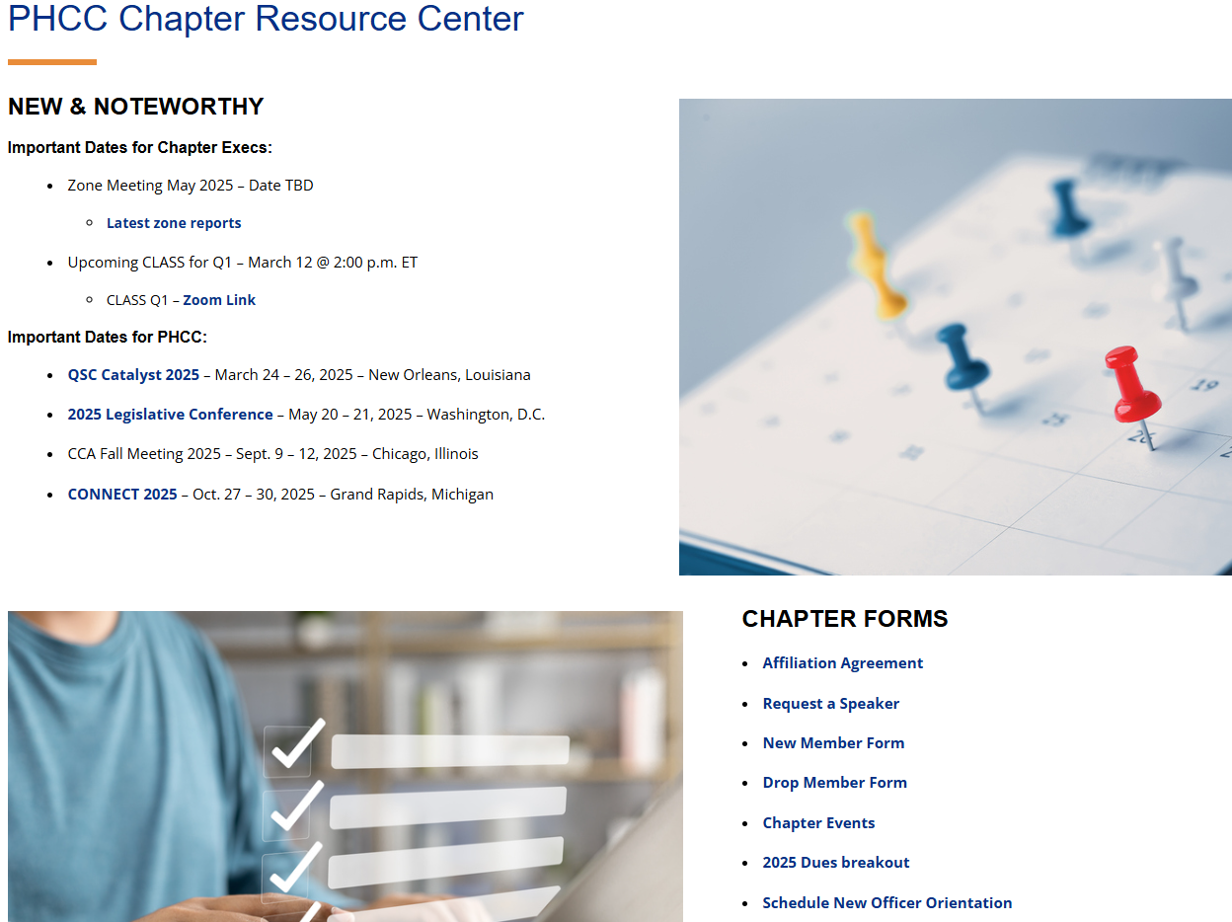
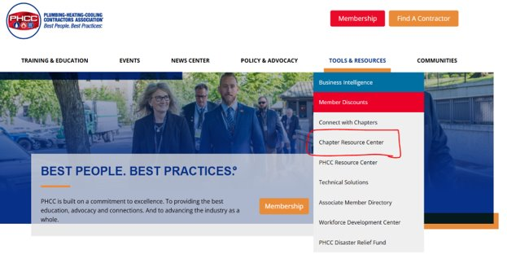
Navigating to the Chapter Resource Center
https://www.phccweb.org/

Slide 4
2025 Renewals by State Chapter

Slide 5
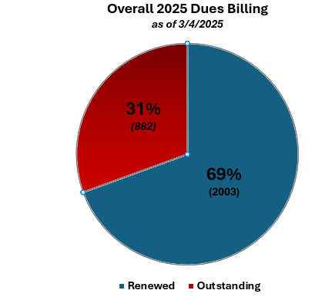
2025 Dues Renewals
2025
2,885 members eligible for renewal
882 yet to renew - (drop date 3/31/2025)
70% dues collected
Year Over Year Comparison
2024
3,023 total members
428 members dropped
Retained 85%
2023
3,119 total members
380 members dropped
Retained 87%

Slide 6

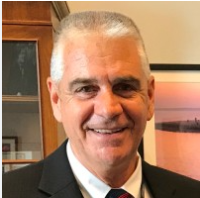


Best Practices & Share Outs
Todd Allred Wayne Thomas
Executive Director Executive Director
PHCC of Washington PHCC of Massachusetts

Slide 7

Questions?

Slide 8

Don't know who to contact at National?
Jordan Fleger ​
fleger@naphcc.org​​
703-752-9879​

Slide 9

Thank you to todays CLASS sponsor

