Slide 1
What’s after High School?
College
Military
Work
Community College/Technical School
Minimum 4 year commitment
Significant expense
Many career options
College needed to become an officer
Options may be limited
Income may be limited
Shorter time commitment
Degree in specific field

Slide 2
Looking for a career that will surprise you?

Slide 3
Check Out Today’s Plumbing & HVAC Careers
Check Out Today’s Plumbing and HVAC Careers

Slide 4
The great pay and benefits will surprise you!

Slide 5
Great Pay + Benefits

Slide 6
The technology will surprise you!

Slide 7
High Tech
Plumbing STEM Skills
HVAC STEM Skills
MATH
Geometry
Ratios
Proportions
Algebra
SCIENCE
Water & Energy Conservation
Biology
Chemistry
Public Health
Physics
ENGINEERING
Building Systems
Fluid Handling Systems
Appliance & Equipment Design
TECHNOLOGY
Circuitry
Control Systems
Instrumentation
Meters
MATH
Geometry
Ratios
Proportions
Algebra
SCIENCE
Ozone Prevention
Air Quality
Biology
Chemistry
Physics
Energy Conservation
ENGINEERING
Building Systems
Fluid Handling Systems
Appliance & Equipment Design
Duct Design & Fabrication
TECHNOLOGY
Circuitry
Control Systems
Instrumentation
Meters

Slide 8
Surprise! YOU are in demand!

Slide 9
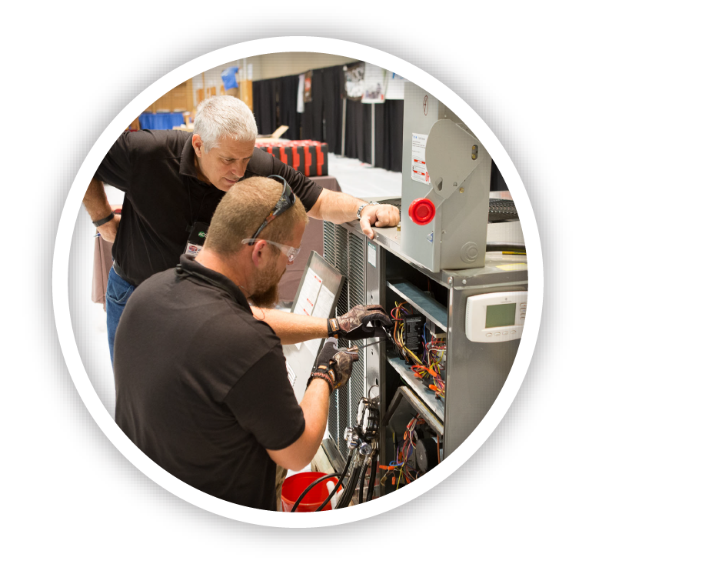
High Demand
The plumbing-heating-cooling industry will need 114,500 new workers by 2028, a 13% increase.

Slide 10
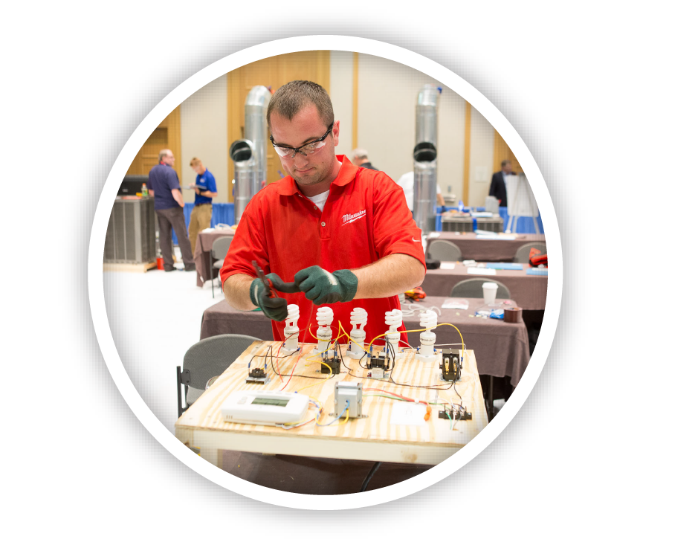
The opportunities will surprise you!

Slide 11
Career Advancement

Slide 12
The work will surprise you – it’s not the same thing over and over!

Slide 13
Secure Future
Work may include:
Designing energy efficient systems
Protecting the water infrastructure
Installing equipment in schools, office buildings, hospitals, restaurants and sports facilities
Installing fixtures and appliances in homes
Repairing and servicing equipment
Solving customers problems

Slide 14
The skills you need will surprise you!

Slide 15
Highly Skilled
Plumbing & HVAC Technicians:
Work with power tools
Are mechanically skilled
Understand blue prints, building models, architectural plans
Are proficient with wires and piping
Must understand physical science
Are skilled with their hands
Execute jobs with exact precision

Slide 16
Surprise! We will train you & pay you while you learn.

Slide 17
How Do I Get Started?
Get paid to work and study through an apprenticeship.
Attend apprenticeship classes.
On-the-job training through an employer.
Attend a community college or technical college program.
Attend a four-year college for business management or mechanical engineering.

Slide 18
The One Thing That WON’T Surprise Me

Slide 19
Why You’ll Love this Career
High Salaries
High Demand
Opportunities for Women
Cutting-Edge Skill Sets
Multiple Career Advancement Paths
Average technician salaries are more than $54,155 plus benefits.
More than 114,500 technicians and installers will be needed by 2028.
Growth of women in the industry is on the rise.
Today’s jobs are highly technical and require a variety of skills such as analyzing and problem solving.
Career opportunities range from technicians to tech-savvy CAD and BIM operators to management.

Slide 20
Questions?
[insert contact information]

